Slide 1
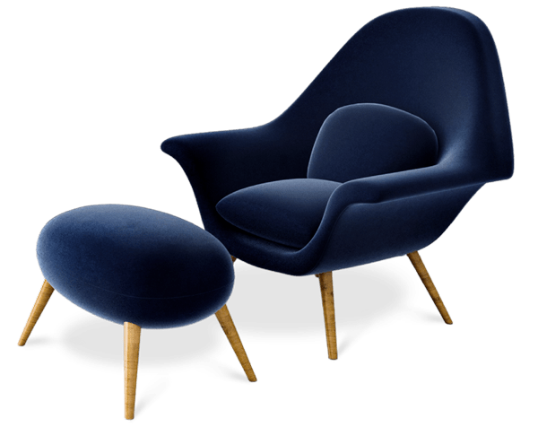

Dwella
Modern.. Stylish.. Appealing..

Slide 2
Mai Amin​
Selvia Emad​
Amina Mohammed

Slide 3
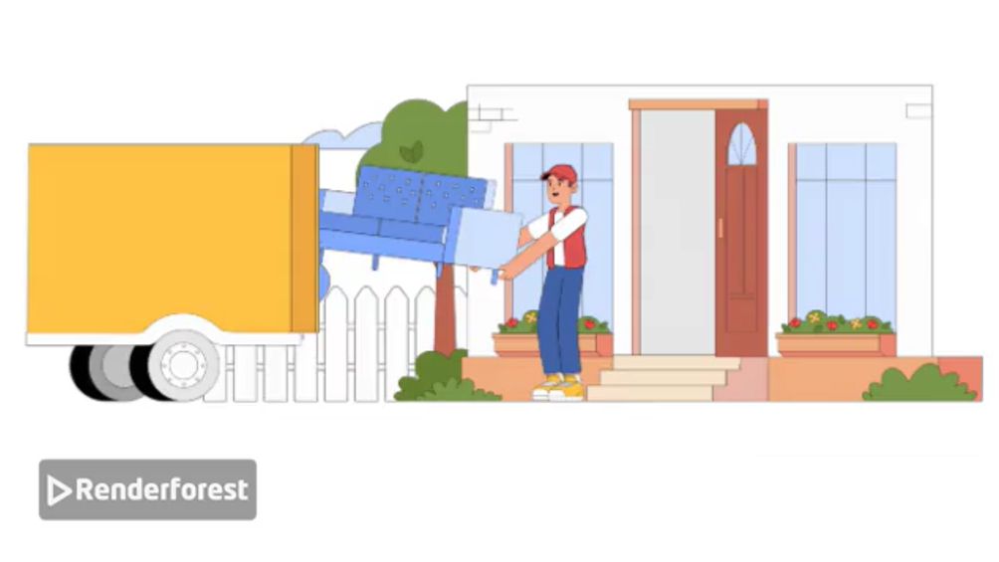

Slide 4

Introduction
Dwella e-commerce platform designed to provide a seamless, elegant, and intuitive shopping experience for customers , making luxury shopping easier, safer, and smarter.

Slide 5
Technologies
Front-end
Back-end
Database

Slide 6
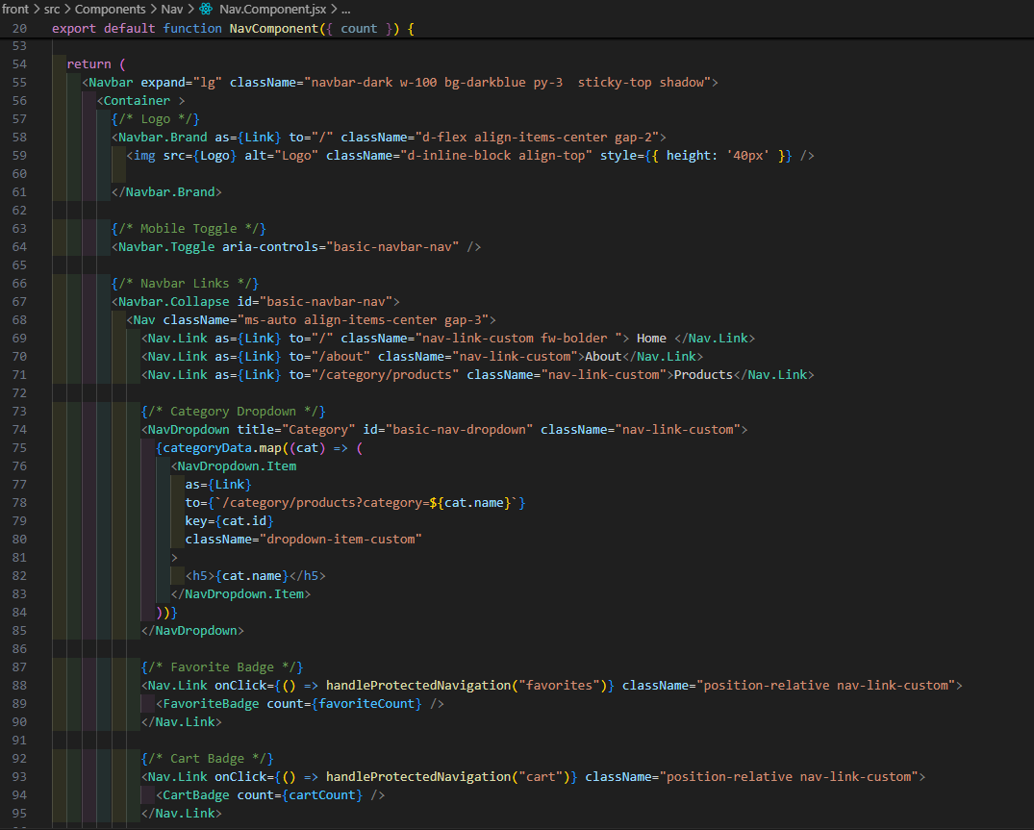
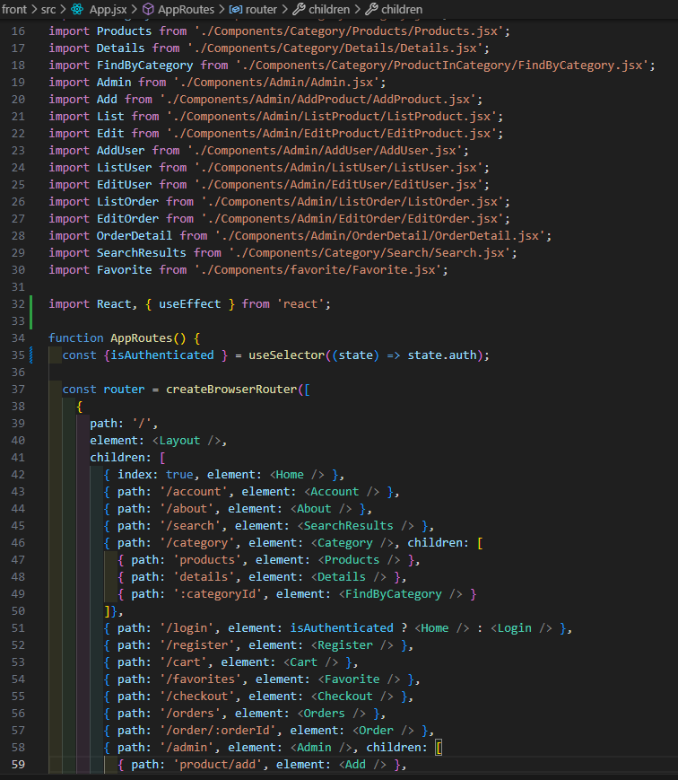
Front-end
HTML
CSS
Bootstrap
JS
ReactJs

Slide 7
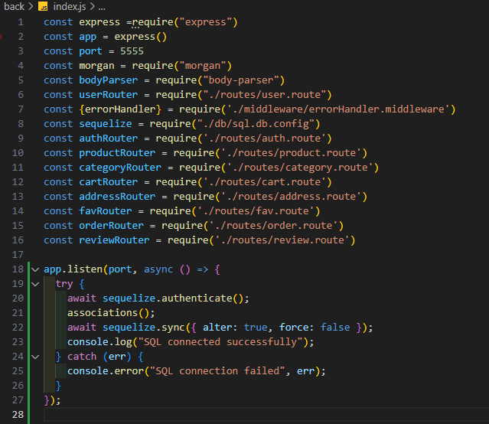
Back-end
JS
NodeJS
Express

Slide 8
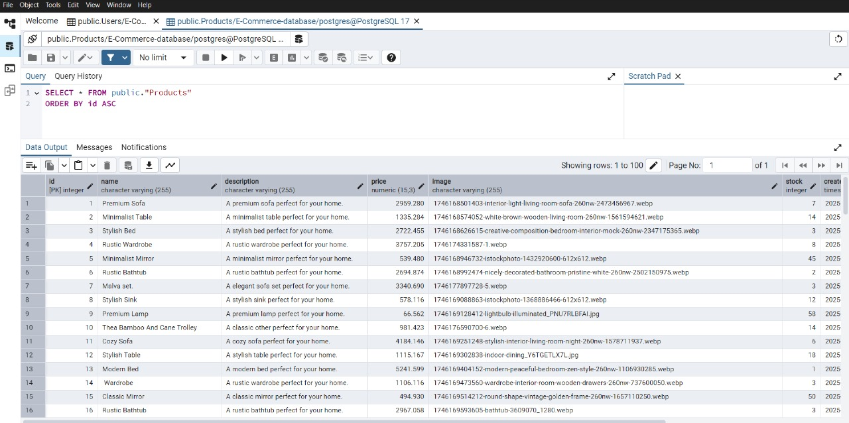
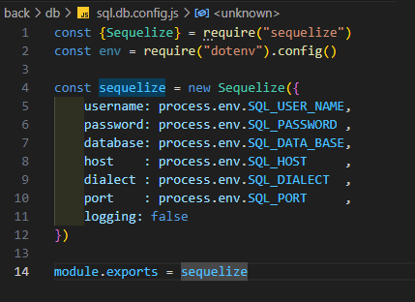
Database
SQL​
Sequelize

Slide 9
Features
Elegant UX/UI
Mobile Friendly
Robust Product Catalog
Smart Shopping Cart
Secure Authentication
Admin dashboard

Slide 10

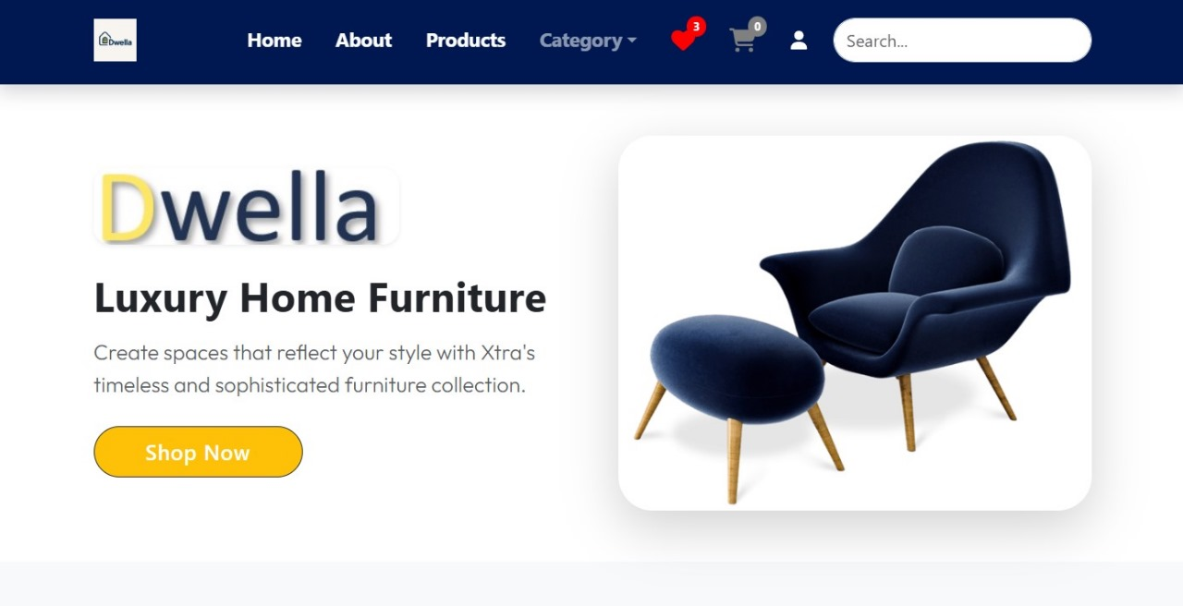
Elegant UX/UI

Slide 11
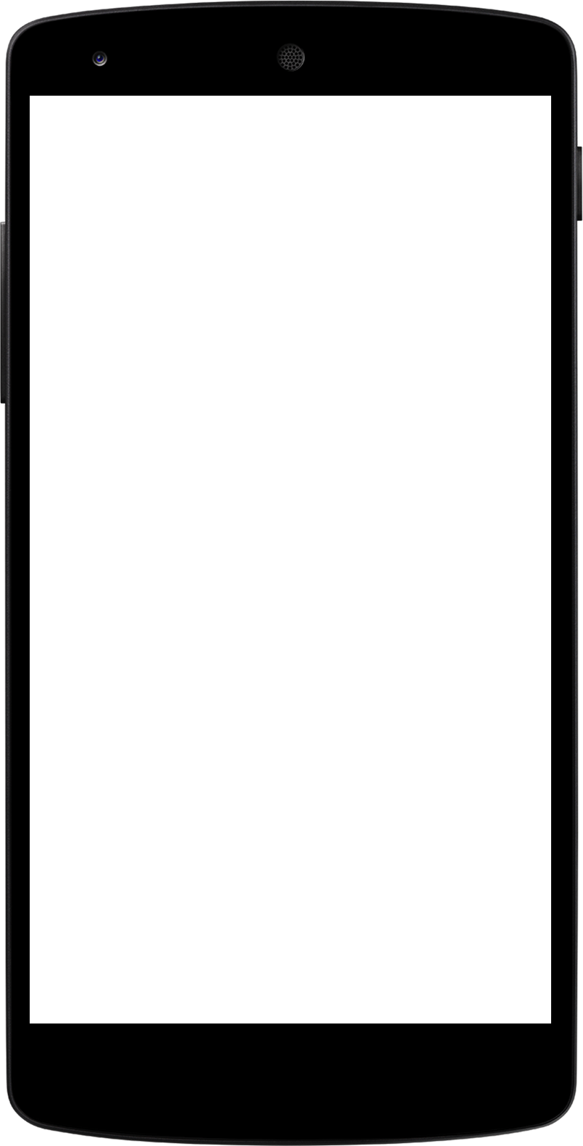
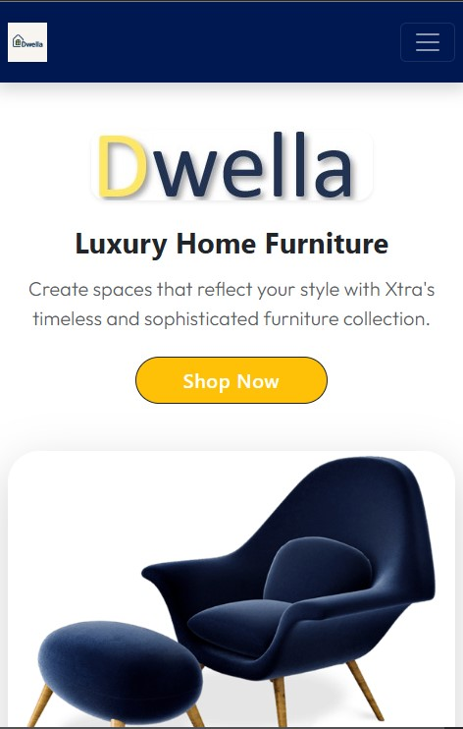
Mobile Friendly

Slide 12
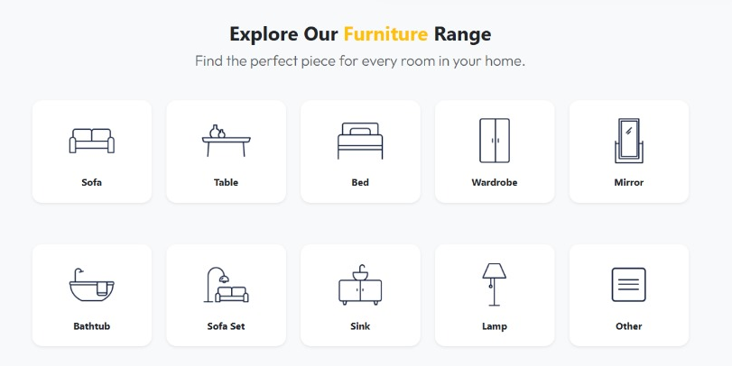
Robust Product Catalog

Slide 13
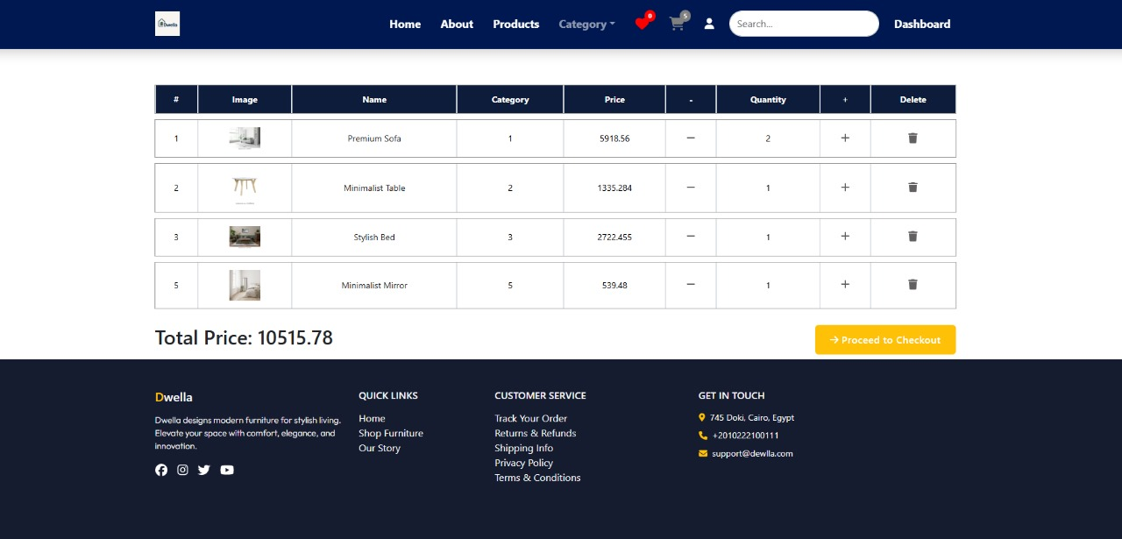
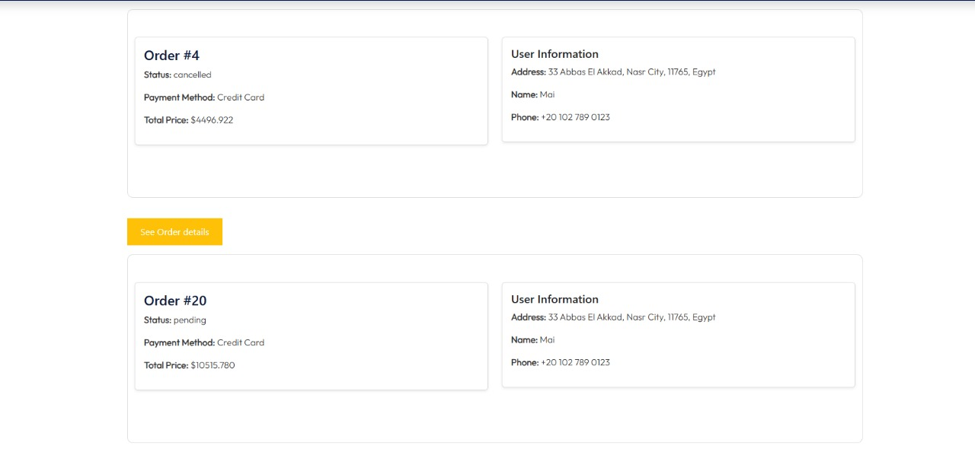
Smart Shopping Cart

Slide 14
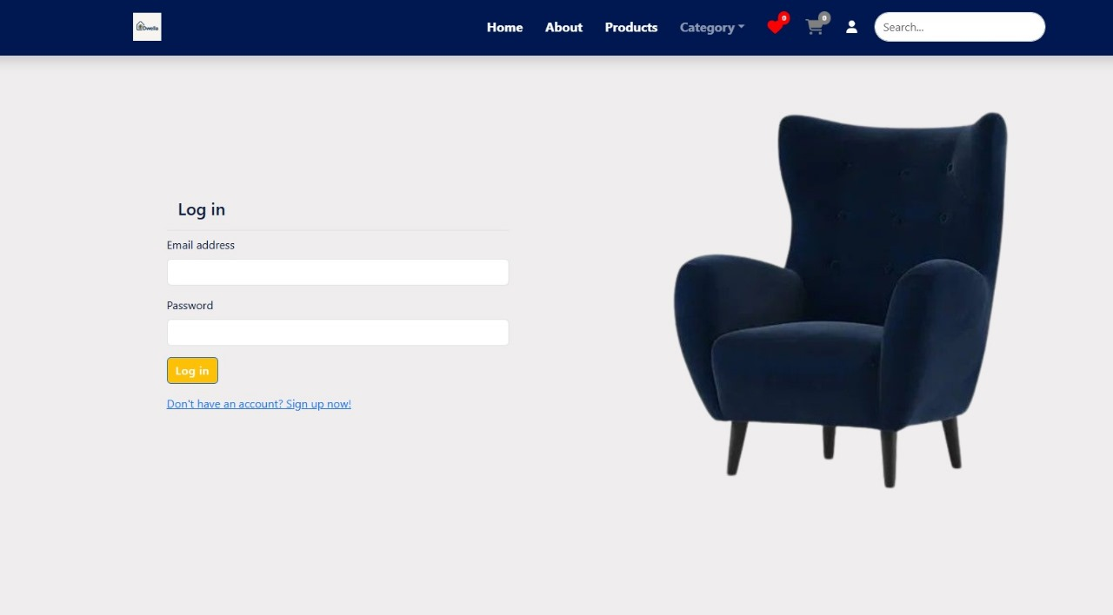
Secure Authentication

Slide 15
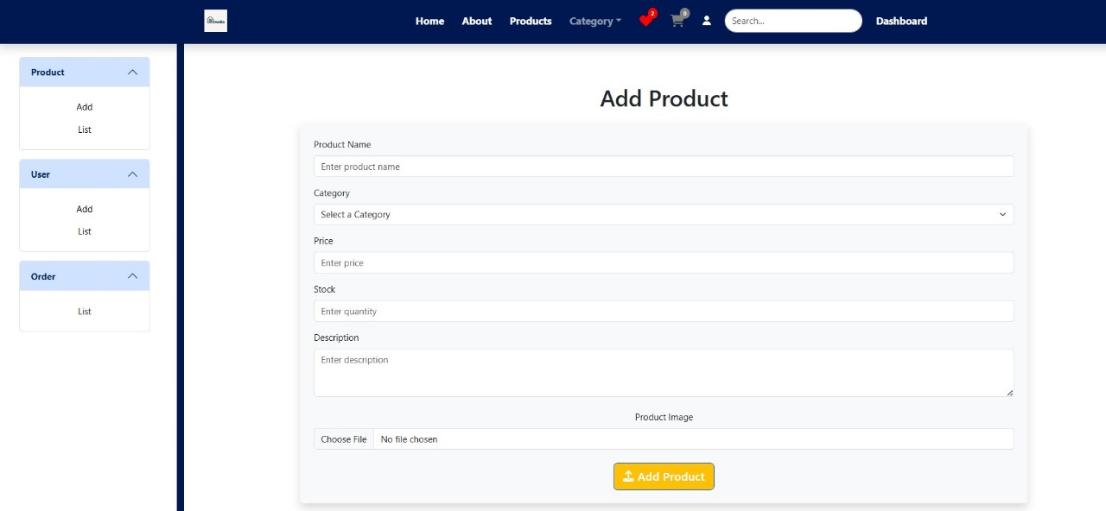
Admin dashboard

Slide 16
Future work
Collaboration with sellers
Customization

Slide 17
Dwella
All Your Furniture
One Click Away !

Slide 18
Thank You

